Slide 1


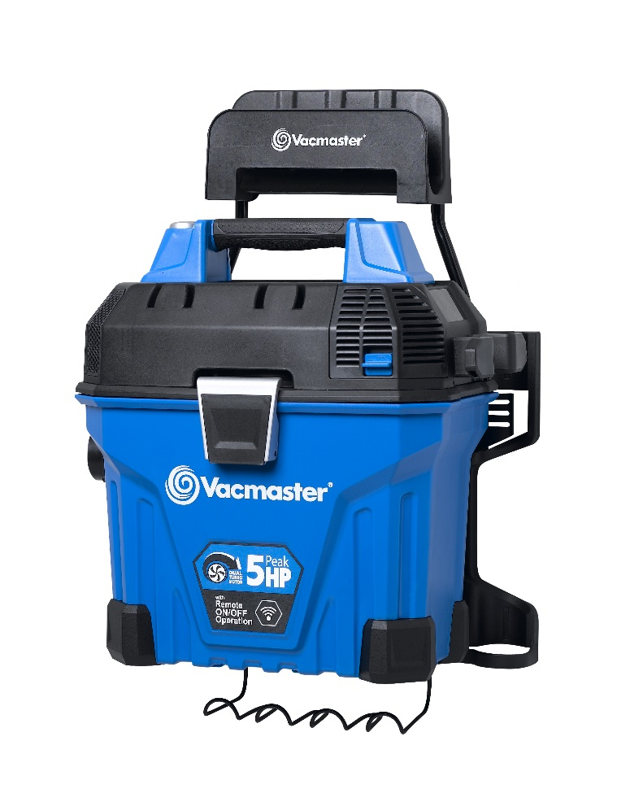
5 Gallon 5 Peak HP Wall Mount Wet/Dry Vac
Features
5 Gal. Polypropylene Tank
Powerful 5 Peak HP Motor
Industrial 2 Stage Motor
Remote Control On/Off Switch
Easy Install Wall Mount
21’ of Hose
20’ Cord with Cord Storage
On Board Accessory Storage
Easily Converts to Blower
Large On/Off Dust Sealed Switch
Large Carry Handle
2 Year Warranty
Accessories
11’ x 1-7/8” Standard Hose
10’ x 1-7/8” Flex Hose
Remote Control Handle
Car Nozzle
Crevice Tool
Blower Nozzle
Utility Nozzle
(2) Extension Wands
Cartridge Filter & Foam Wet Filter
Storage Rack
Air Watts | 200
CFM | 110
Water Lift (in) | 80
Suggested Retail: $119.00
Model # | MP Box (in.) | MP Qty | MP Weight (lbs.) | 20’ Container | 40’ Container | 40’H Container | UPC Code
VWMB508 0101 | 21.2 X 13.3 x 20.7 | 1 | 23.36 | 264 | 552 | 690 | 814953013563

