Slide 1


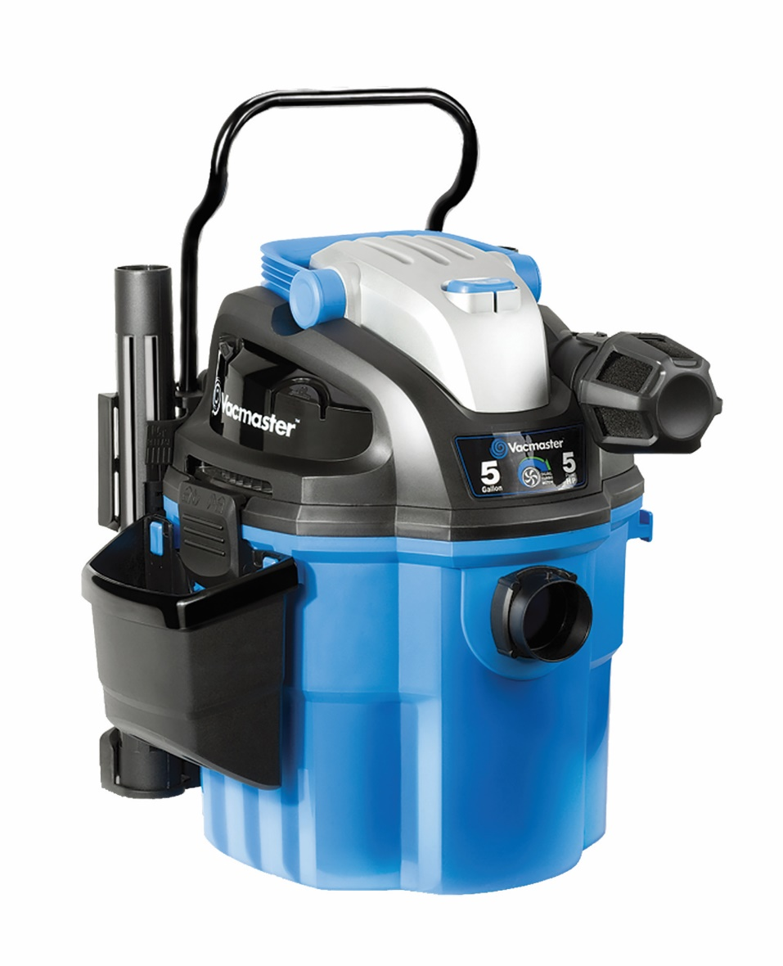

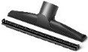
5 Gallon 5 Peak HP Wall Mount Wet/Dry Vac
Features
5 Gal. Polypropylene Tank
Powerful 5 Peak HP Motor
Industrial 2 Stage Motor
Remote Control On/Off Switch
Easy Install Wall Mount
21’ of Hose
20’ Cord with Cord Storage
On Board Accessory Storage
Easily Converts to Blower
Large On/Off Dust Sealed Switch
Large Carry Handle
2 Year Warranty
Accessories
10’ x 1-7/8” Hose
11’ x 1-7/8” Flex Hose
Remote Control Handle
Car Nozzle
Crevice Tool
Floor Nozzle
(2) Extension Wands
Cartridge Filter & Foam Wet Filter
Noise Diffuser
Caddy
Air Watts | 155
CFM | 75
Water Lift (in) | 68
Suggested Retail: $119.00
Model # | MP Box (in.) | MP Qty | MP Weight (lbs.) | 20’ Container | 40’ Container | 40’H Container | UPC Code
VWM510 | 18.5 x 15.4 x 20.8 | 1 | 25.31 | 288 | 600 | 747 | 899794001535

