Slide 1


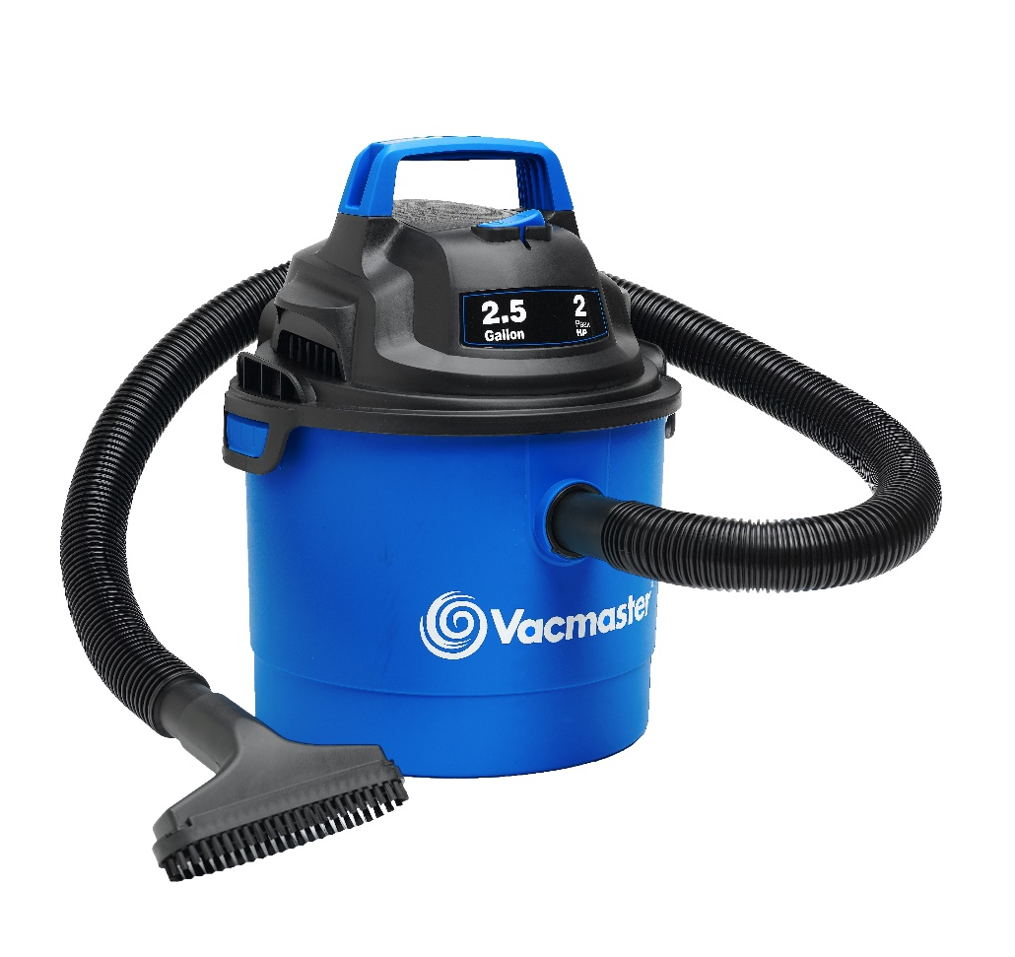
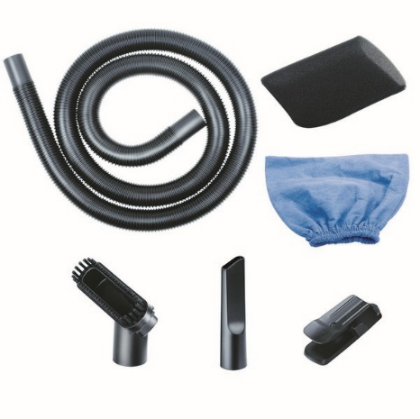
2.5 Gallon 2 Peak HP Wet/Dry Vac
Features
2.5 Gal. Polypropylene Tank
Powerful 2 Peak HP Motor
Wall Mount Storage
6’ Cord with Cord Storage
Easily Converts to Blower
Large On/Off Dust Sealed Switch
Balanced Top Handle Design
2 Year Warranty
Accessories
4’ x 1-1/4” Hose
2-in-1 Utility Nozzle
Crevice Tool
Wall Hook
Cloth Filter
Foam Wet Filter
Air Watts | 100
CFM | 60
Water Lift (in) | 48
Suggested Retail: $34.99
Model # | MP Box (in.) | MP Qty | MP Weight (lbs.) | 20’ Container | 40’ Container | 40’H Container | UPC Code
VOM205P | 11.54 x 11.54 x 13.58 | 1 | 7.05 | 1064 | 2136 | 2456 | 814953010487

