Slide 1


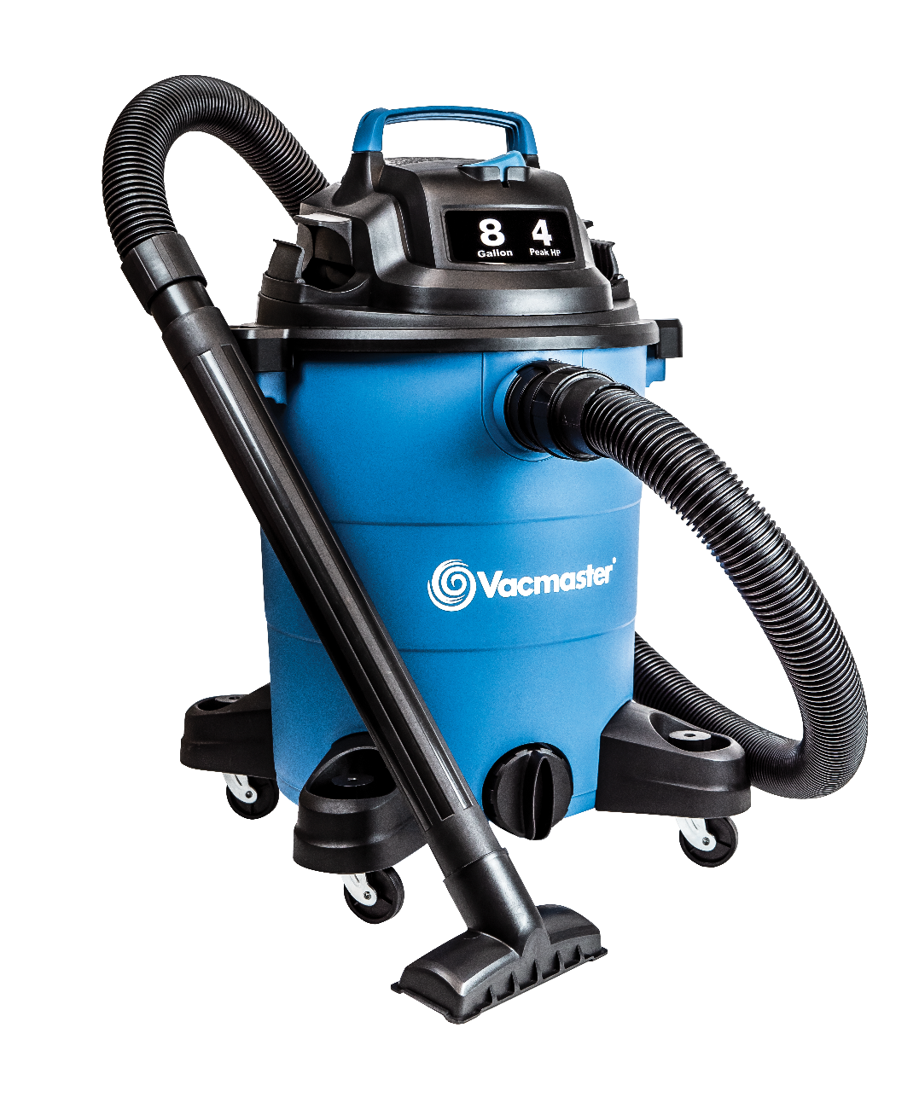
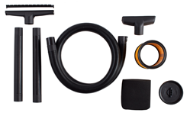
8 Gallon 4 Peak HP Wet/Dry Vac
Features
8 Gal. Polypropylene Tank
4 Peak HP
Integrated Hose Storage
10’ Cord with Cord Storage
Easily Converts to Blower
Extra Large Drain Port
Storage on Casters & Power Head
Large On/Off Dust Sealed Switch
Balanced Top Handle Design
2 Year Warranty
Accessories
7’ x 1-7/8” Hose
Utility Nozzle
Floor Nozzle
(2) Extension Wands
Cartridge Filter
Foam Wet Filter
Air Watts | 165
CFM | 76
Water Lift (in) | 64
Suggested Retail: $69.99
Model # | MP Box (in.) | MP Qty | MP Weight (lbs.) | 20’ Container | 40’ Container | 40’H Container | UPC Code
VOC809PF | 14.57 x 14.57 x 21.97 | 1 | 16.09 | 360 | 744 | 870 | 814953014645

