Slide 1


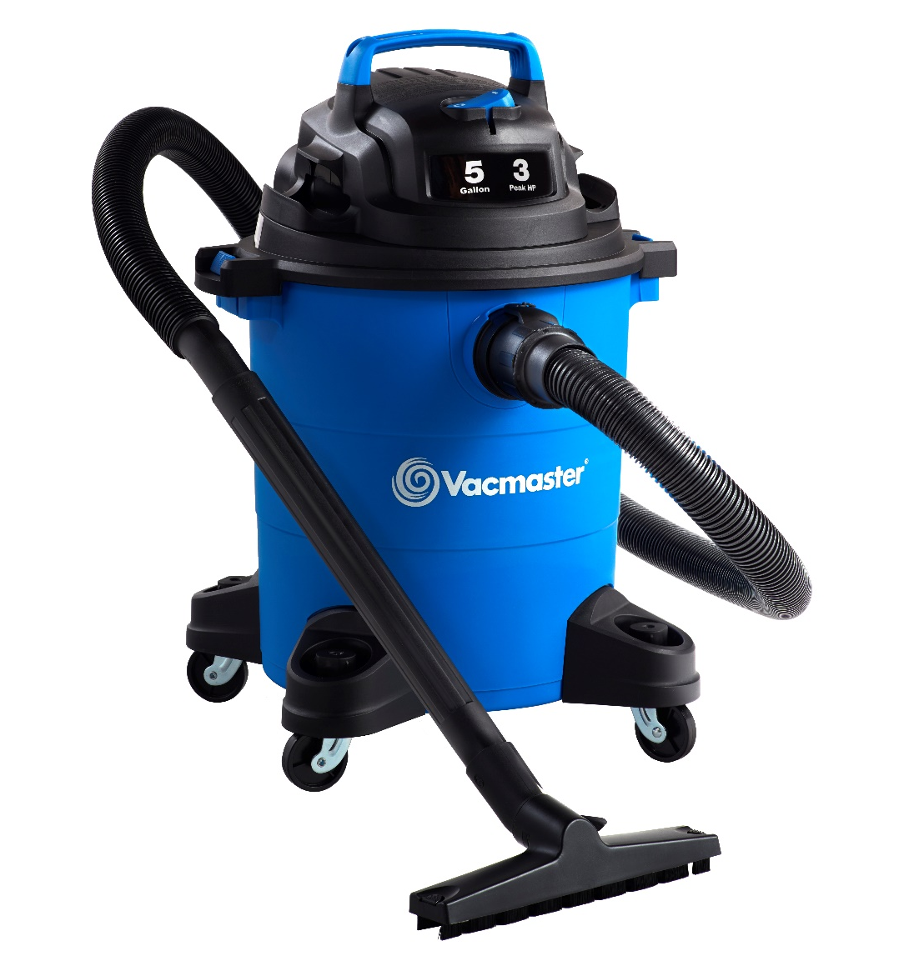
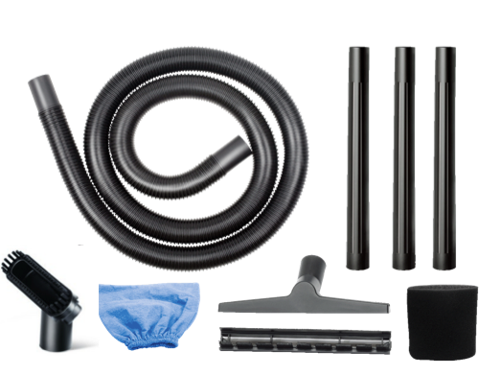
5 Gallon 3 Peak HP Wet/Dry Vac
Features
5 Gal. Polypropylene Tank
Powerful 3 Peak HP Motor
Integrated Hose Storage
8’ Cord with Cord Storage
Easily Converts to Blower
Storage on Casters & Power Head
Large On/Off Dust Sealed Switch
Balanced Top Handle Design
2 Year Warranty
Accessories
6’ x 1-1/4” Hose
2-in-1 Utility Nozzle
Floor Nozzle
(3) Extension Wands
Cloth Filter
Foam Wet Filter
Air Watts | 135
CFM | 65
Water Lift (in) | 56
Suggested Retail: $44.99
Model # | MP Box (in.) | MP Qty | MP Weight (lbs.) | 20’ Container | 40’ Container | 40’H Container | UPC Code
VOC507PF | 13 x 13 x 19.4 | 1 | 12.43 | 553 | 1176 | 1260 | 814953014683

