Slide 1
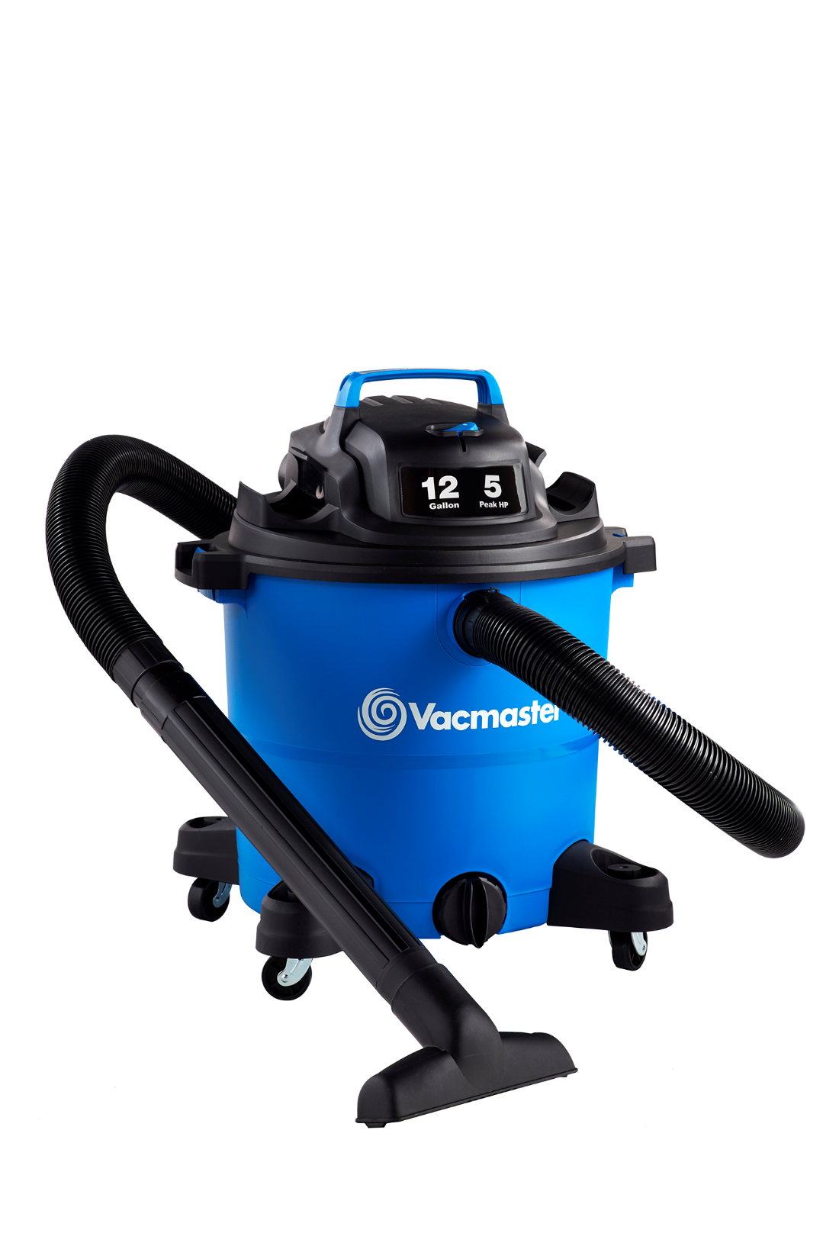


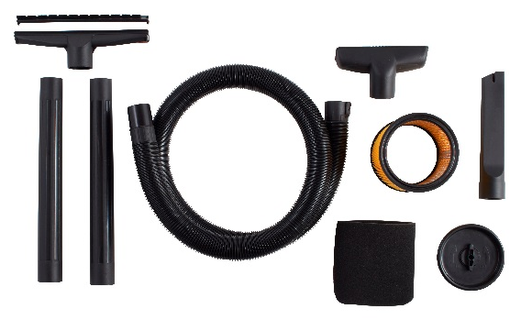
12 Gallon 5 Peak HP Wet/Dry Vac
Features
12 Gal. Polypropylene Tank
5 Peak HP
Integrated Hose Storage
12’ Cord with Cord Wrap
Easily Converts to Blower
Extra Large Drain Port
Storage on Power Head
Large On/Off Dust Sealed Switch
Balanced Top Handle Design
2 Year Warranty
Accessories
7’ x 2-1/2” Hose
Utility Nozzle
Floor Nozzle
Crevice Tool
(2) Extension Wands
Cartridge Filter
Foam Wet Filter
Air Watts | 270
CFM | 106
Water Lift (in) | 60
Suggested Retail: $79.99
Model # | MP Box (in.) | MP Qty | MP Weight (lbs.) | 20’ Container | 40’ Container | 40’H Container | UPC Code
VOC1210PF | 17.91 x 17.91 x 21.77 | 1 | 22.38 | 240 | 520 | 625 | 814953014690

