Slide 1


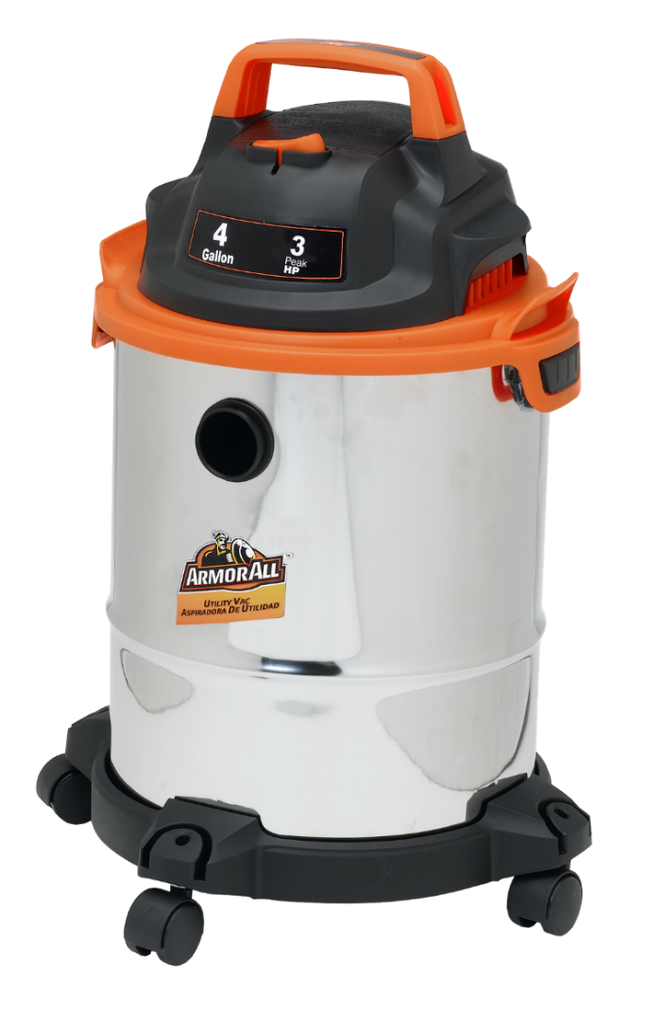

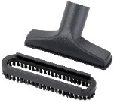
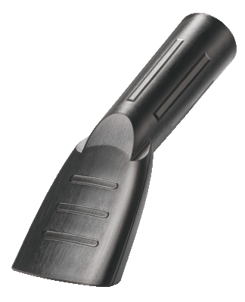
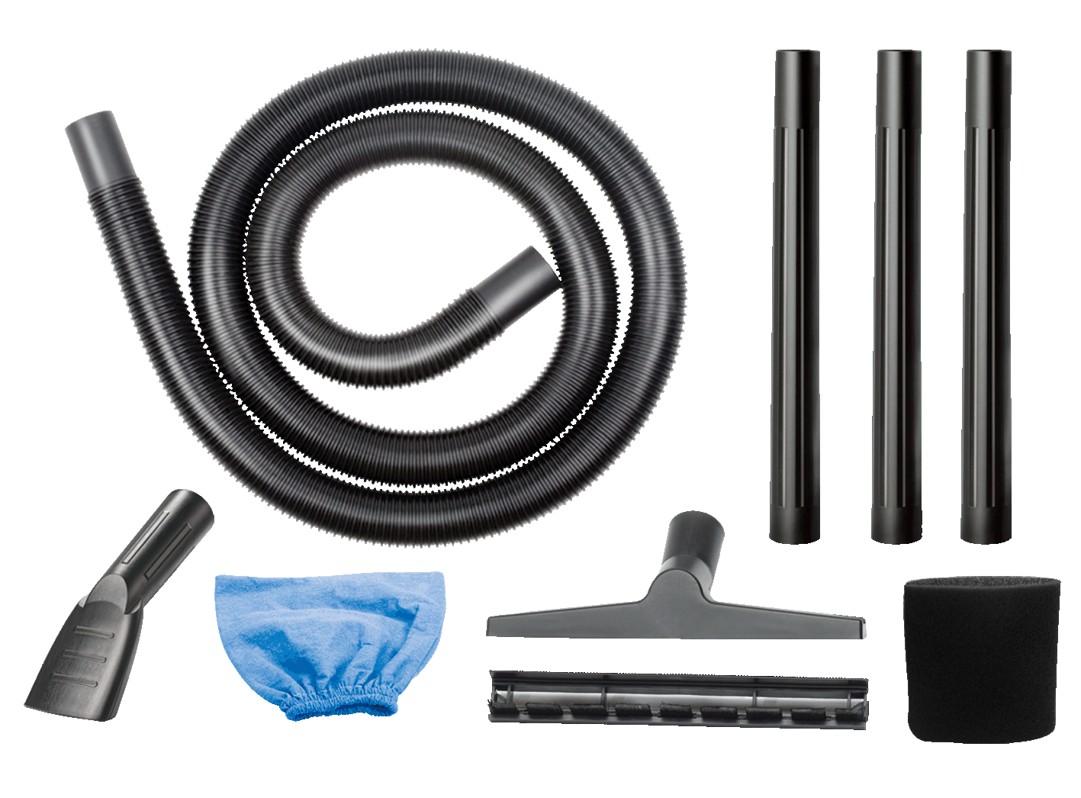
4 Gal 3 Peak HP Stainless Steel Wet/Dry Vac
Features
4 Gal. Stainless Steel Tank
3 Peak HP Motor
8 Ft. Cord With Cord Wrap
On-board Accessory & Hose Storage
Blower Function – Easy Conversion
Balanced Top Handle
Large On/Off Switch
2 Year Warranty
Accessories
6 ft. Hose x 1-1/4 In. Diameter
3 Extension Wands
Reusable Cloth Filter
Reusable Foam Sleeve
10 In. Floor/Squeegee Nozzle
Crevice Tool
2-in-1 Utility Nozzle
Car Nozzle
Base with Casters
Air Watts | 135
CFM | 65
Water Lift (in) | 60
Suggested Retail: $44.99
The Armor All trademark(s) is/are trademarks of the Armor All/STP Products Company and are used under license.
Model # | MP Box in. | MP Qty | Weight lbs. | 20’ Container | 40’ Container | 40’H Container | UPC Code
VO408S 0901 | 11.81 x 11.42 x 17.44 | 1 | 10.21 | 665 | 1365 | 1547 | 814953012559
Notes:
1
1

