Slide 1



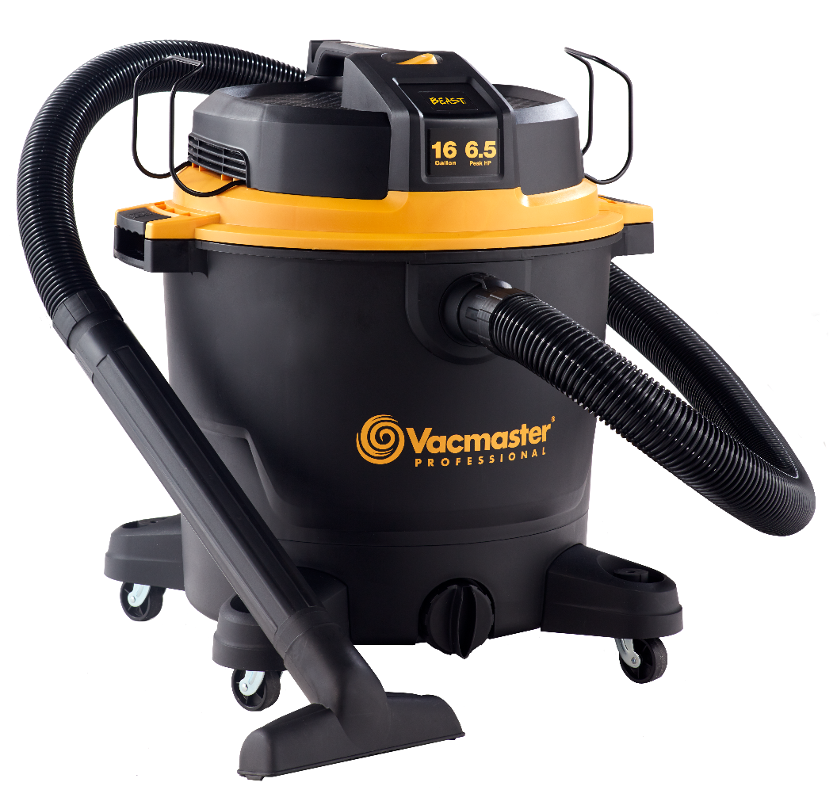
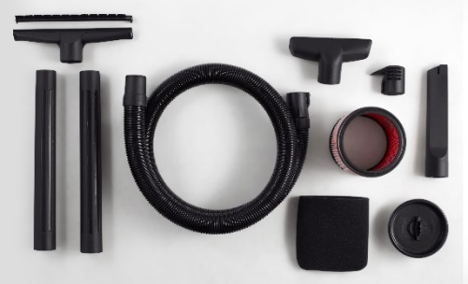
16 Gallon 6.5 HP Wet/Dry Vac
Features
16 Gal. Polypropylene Tank
6.5 Peak HP Ultimate Performance
Motor
Integrated Hose Storage
20’ Cord with Cord Wrap
Easily Converts to Blower
Extra Large Drain Port
Storage on Casters & Power Head
Large On/Off Dust Sealed Switch
Balanced Top Handle Design
5 Year Warranty
Accessories
7’ x 2-1/2” Kink Resistant EVA Hose
Utility Nozzle
Floor Nozzle
Crevice Tool
(2) Extension Wands
Fine Dust Cartridge Filter
Foam Wet Filter
Noise Diffuser
Air Watts | 400
CFM | 150
Water Lift (in) | 64
Suggested Retail: $129.99
Model # | MP Box (in.) | MP Qty | MP Weight (lbs.) | 20’ Container | 40’ Container | 40’H Container | UPC Code
VJH1612PF 0201 | 19.88 x 19.88 x 23.82 | 1 | 29.41 | 168 | 352 | 368 | 814953014720

