Slide 1


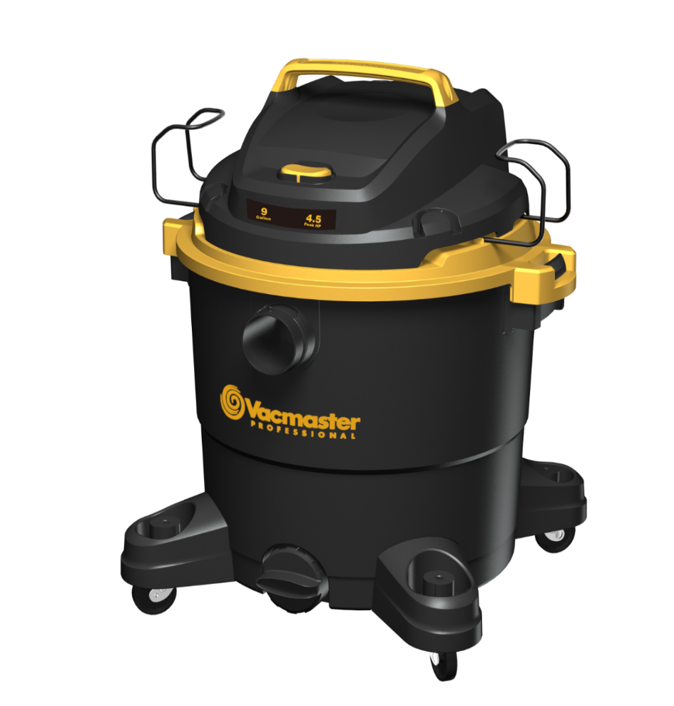
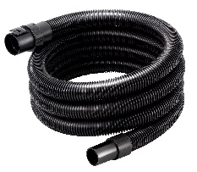
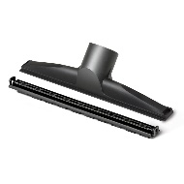
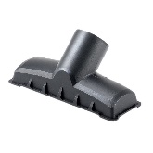
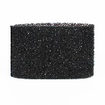
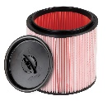
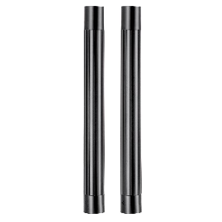
9 Gallon 4.5 Peak HP Wet/Dry Vac
Features
9 Gal. Polypropylene Tank
Integrated Hose Storage
10’ Cord with Cord Wrap
Extra Large Drain Port
Easily Converts to Blower
Storage on Casters & Power Head
Large On/Off Dust Sealed Switch
Balanced Top Handle Design
3 Year Warranty
Accessories
7’ x 1-7/8” Kink Resistant EVA Hose
Utility Nozzle
Floor Nozzle
(2) Extension Wands
Fine Dust Cartridge Filter
Foam Wet Filter
Air Watts | 260*
CFM | 101*
Water Lift (in) | 72*
*Indicates estimate
Model # | MP Box (in.) | MP Qty | MP Weight (lbs.) | 20’ Container | 40’ Container | 40’H Container | UPC Code
VJF912PF 0201 | 16.9 X 16.9 X 22 | 1 | 18.5 | 260 | 540 | 645 | 814953017325

