Slide 1



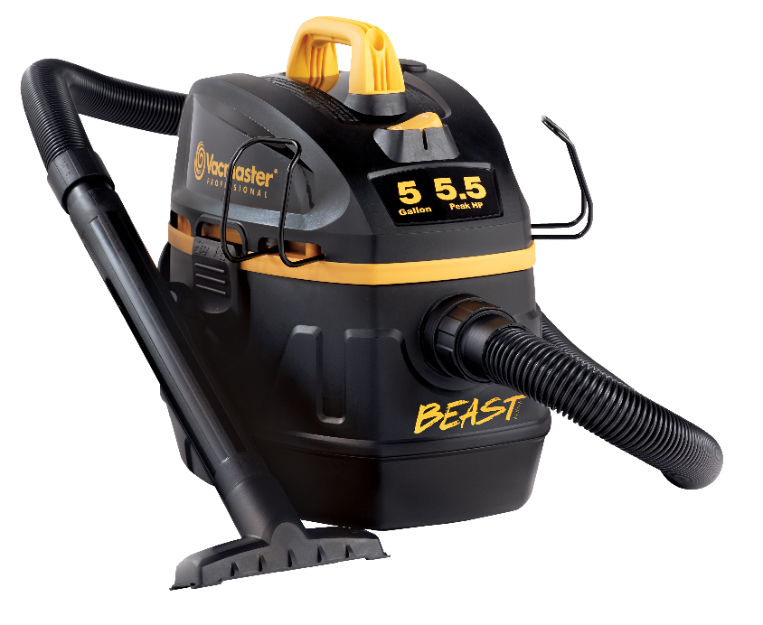
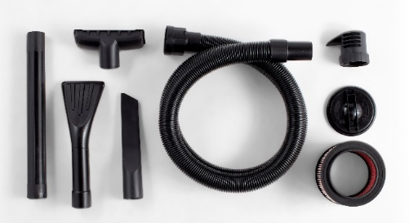
5 Gallon 5.5 Peak HP Jobsite Wet/Dry Vac
Features
5 Gal. Polypropylene Tank
Powerful 5.5 Peak HP
High Water Lift Motor
Integrated On-Board Hose Storage
18’ Cord with Cord Wrap
Easily Converts to Blower
Large On/Off Dust Sealed Switch
Balanced Top Handle Design
5 Year Warranty
Accessories
7’ x 1-7/8” Kink Resistant EVA Hose
Utility Nozzle
Crevice Tool
(1) Extension Wand
Car Nozzle
Fine Dust Cartridge Filter
Foam Wet Filter
Noise Diffuser
Air Watts | 320
CFM | 102
Water Lift (in) | 82
Suggested Retail: $89.99
Model # | MP Box (in.) | MP Qty | MP Weight (lbs.) | 20’ Container | 40’ Container | 40’H Container | UPC Code
VFB511B 0201 | 18.58 x 13.43 x 16.5 | 1 | 18.52 | 415 | 838 | 1006 | 814953014737

