Slide 1


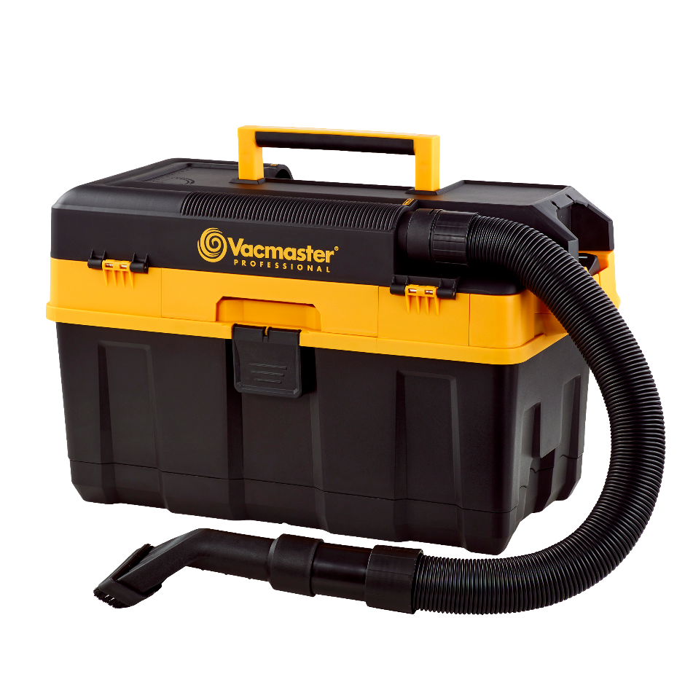
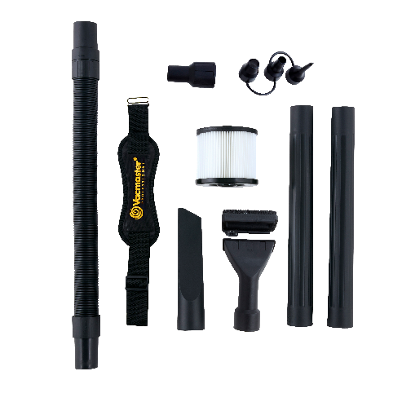
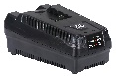
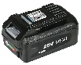
20V Cordless Jobsite Wet/Dry Vac
Features:
4 Gal. Polypropylene Tank
20V 4.0Ah Lithium Ion Battery
High Performance Cordless Motor
Integrated Hose Storage
Cord-free Operation
Easily Converts to Blower
Floor-to-Ceiling Cleaning Solution
Fully Enclosed Accessory Storage
Large On/Off Dust Sealed Switch
Convenient Toolbox Design
Padded Shoulder Strap
Built-in Bottle Opener
5 Year Tool Warranty
Accessories:
6’ x 1-7/8” Flex Hose
Car/Utility Hybrid Nozzle with Brush
Flexible Crevice Tool
1-7/8” to 1-1/4” Adapter
3-pc. Inflator Nozzle Adapter
(2) Extension Wands
Washable HEPA-Material Cartridge Filter
Air Watts | 115
CFM | 59
Water Lift (in) | 52
Suggested Retail: $149.00
Model # | MP Box (in.) | MP Qty | MP Weight (lbs.) | 20’ Container | 40’ Container | 40’H Container | UPC Code
DVTB204 0201 | 21.8 x 10.8 x 13.2 | 1 | 16.7 | 560 | 1130 | 1340 | 814953015413

